Slide 1
Quotes from U.S. Presidents
Unit 4
The People, the Preamble, and the Presidents
Fluency Practice
RF.3.4

Slide 2
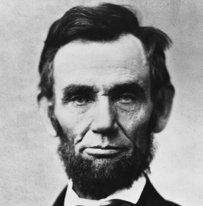
I am a success today because I had a friend who believed in me and I didn’t have the heart to let him down…
Abraham Lincoln

Slide 3
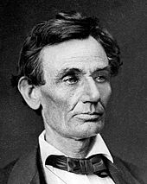
If I had eight hours to chop down a tree, I’d spend six hours sharpening my ax.
Abraham Lincoln

Slide 4
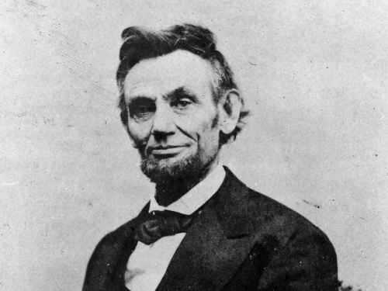
Most folks are about as happy as they make their minds up to be.
Abraham Lincoln

Slide 5
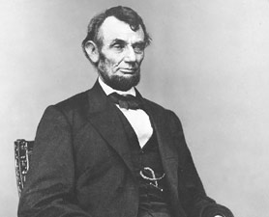
My great concern is not whether you have failed, but whether you are content with your failure.
Abraham Lincoln

Slide 6
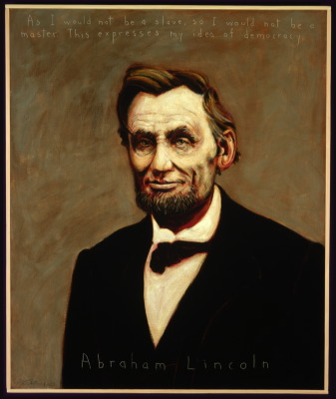
Better to remain silent and be thought a fool than to speak out and remove all doubt.
Abraham Lincoln

Slide 7
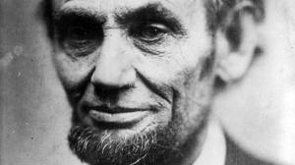
I destroy my enemies when I make them my friends.
Abraham Lincoln

Slide 8
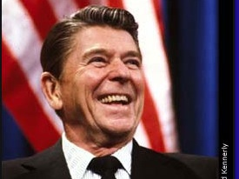
There are no easy answers, but there are simple answers. We must have the courage to do what we know is morally right.
Ronald Reagan

Slide 9
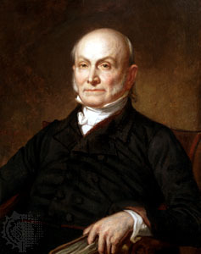
If you actions inspire others to dream more, learn more, do more and become more, you are a leader.
John Quincy Adams

Slide 10
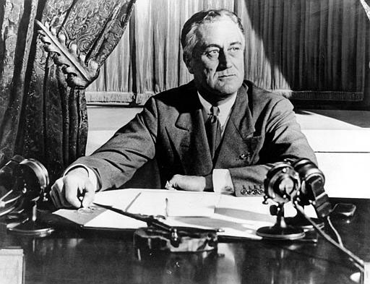
The only thing to fear is, fear itself.
Franklin D. Roosevelt

Slide 11
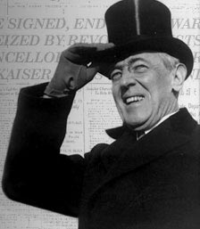
No nation is fit to sit in judgment upon any other nation.
Woodrow Wilson

Slide 12
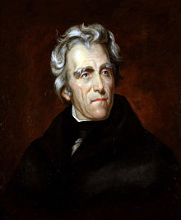
Any many worth his salt will stick up for what he believes right, but it takes a slightly better man to acknowledge instantly and without reservation that he is in error.
Andrew Jackson

Slide 13
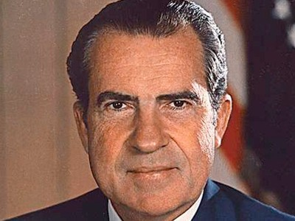
A man is not finished when he is defeated. He is finished when he quits.
Richard Nixon

Slide 14
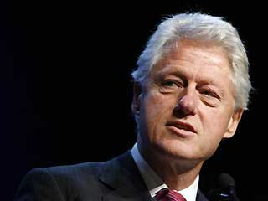
We must teach our children to resolve their conflicts with words, not weapons.
Bill Clinton

Slide 15
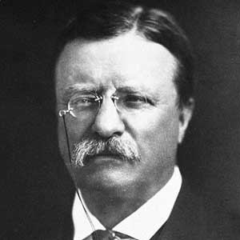
It is hard to fail, but it is worse never to have tried to succeed. In this life we get nothing save by effort.
Theodore Roosevelt

Slide 16
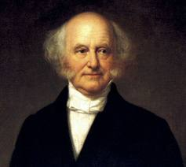
It is easier to do a job right than to explain why you didn’t.
Martin Van Buren

Slide 17
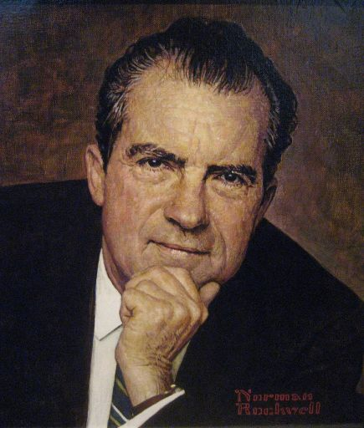
Always give your best, never get discouraged, never be petty; always remember, other may hate you. Those who hate you don’t win unless you hate them. And then you destroy yourself.
Richard Nixon

Slide 18
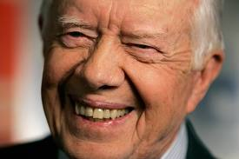
We must adjust to changing times and still hold to unchanging principles.
James “Jimmy” Carter

Slide 19
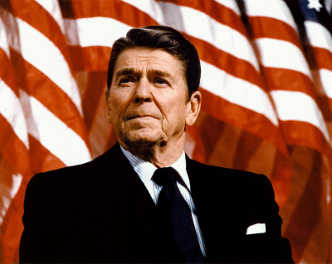
America is too great for small dreams.
Ronald Reagan

Slide 20
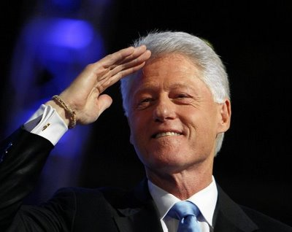
If you live long enough, you’ll make mistakes. But if you learn from them, you’ll be a better person. It’s how you handle adversity, not how it affects you. The main thing is never quit, never quit, never quit.
Bill Clinton

Slide 21
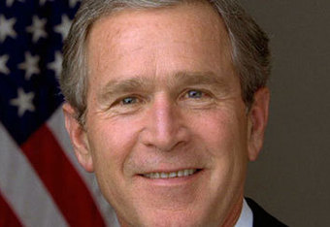
Recognizing and confronting our history is important. Transcending our history is important. Transcending our history is essential. We are not limited by what we have done, or what we have left undone. We are limited only by what we are willing to do.
George W. Bush

Slide 22
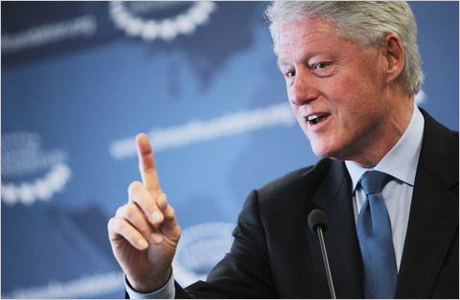
We need a spirit of community, a sense that we are all in this together. If we have no sense of community, the American dream will wither.
Bill Clinton

Slide 23
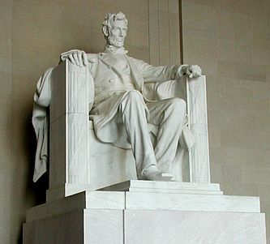
In the end, it’s not the years in your life that count. It’s the life in your years.
Abraham Lincoln

Slide 24
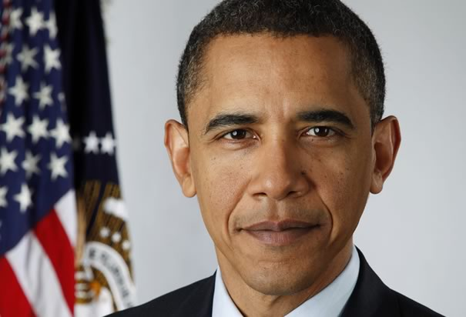
If you are walking down the right path and you’re willing to keep walking, eventually you’ll make progress.
Barack Obama

Slide 25
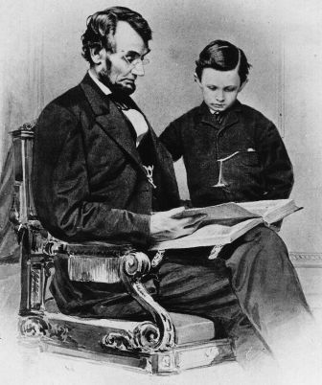
The things I want to know are in books; my best friend is the man who’ll get me a book I ain’t read.
Abraham Lincoln

Slide 26
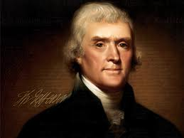
In matters of style, swim with the current; in matters of principle, stand like a rock.
Thomas Jefferson

Slide 27
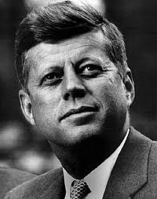
And so, my fellow Americans: ask not what your country can do for you-ask what you can do for your country. My fellow citizens of the world: ask not what American will do for you, but what together we can do for the freedom of man.
John F. Kennedy

